Slide 1


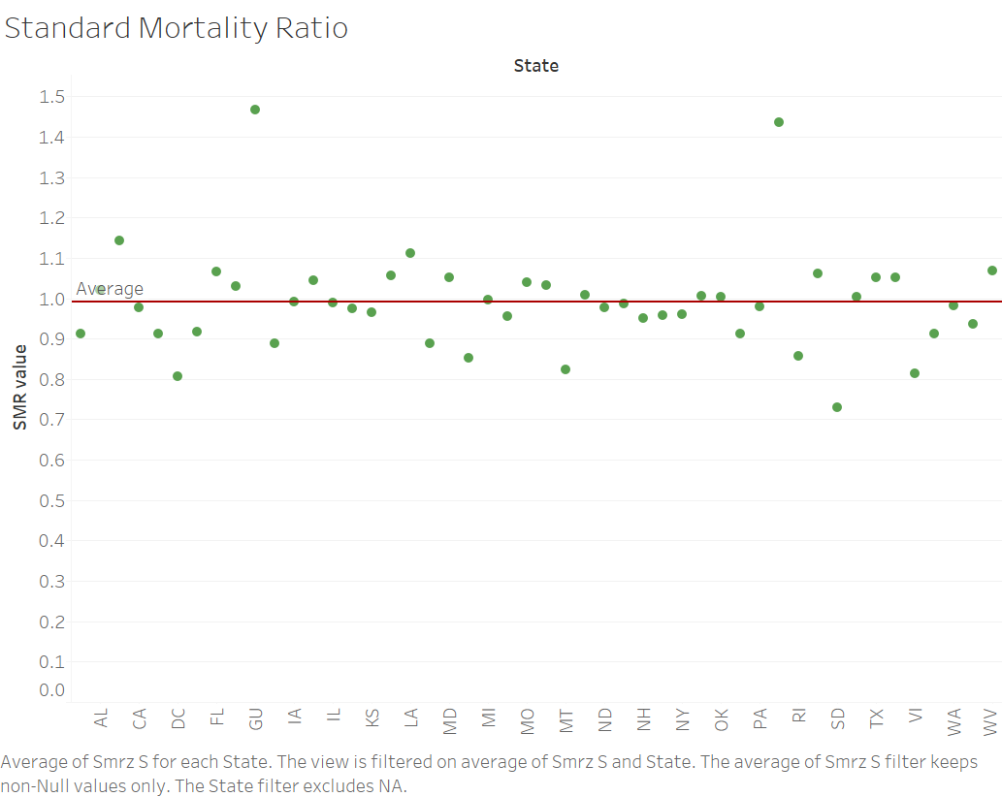
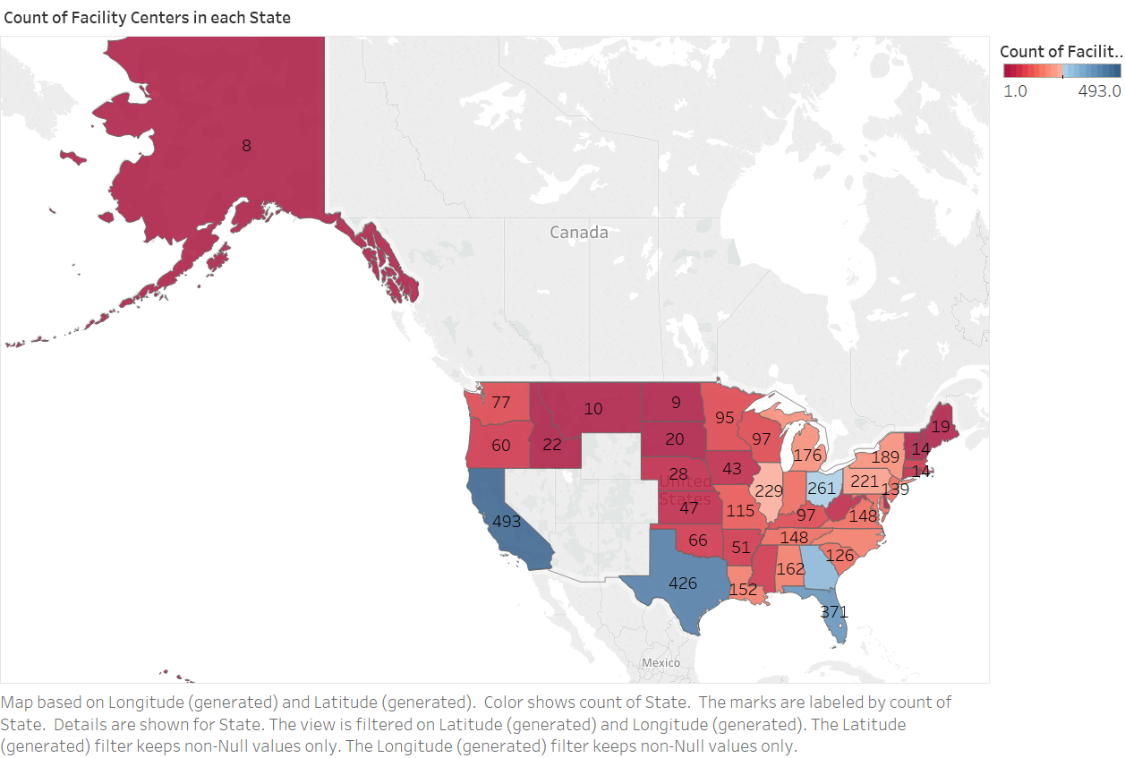
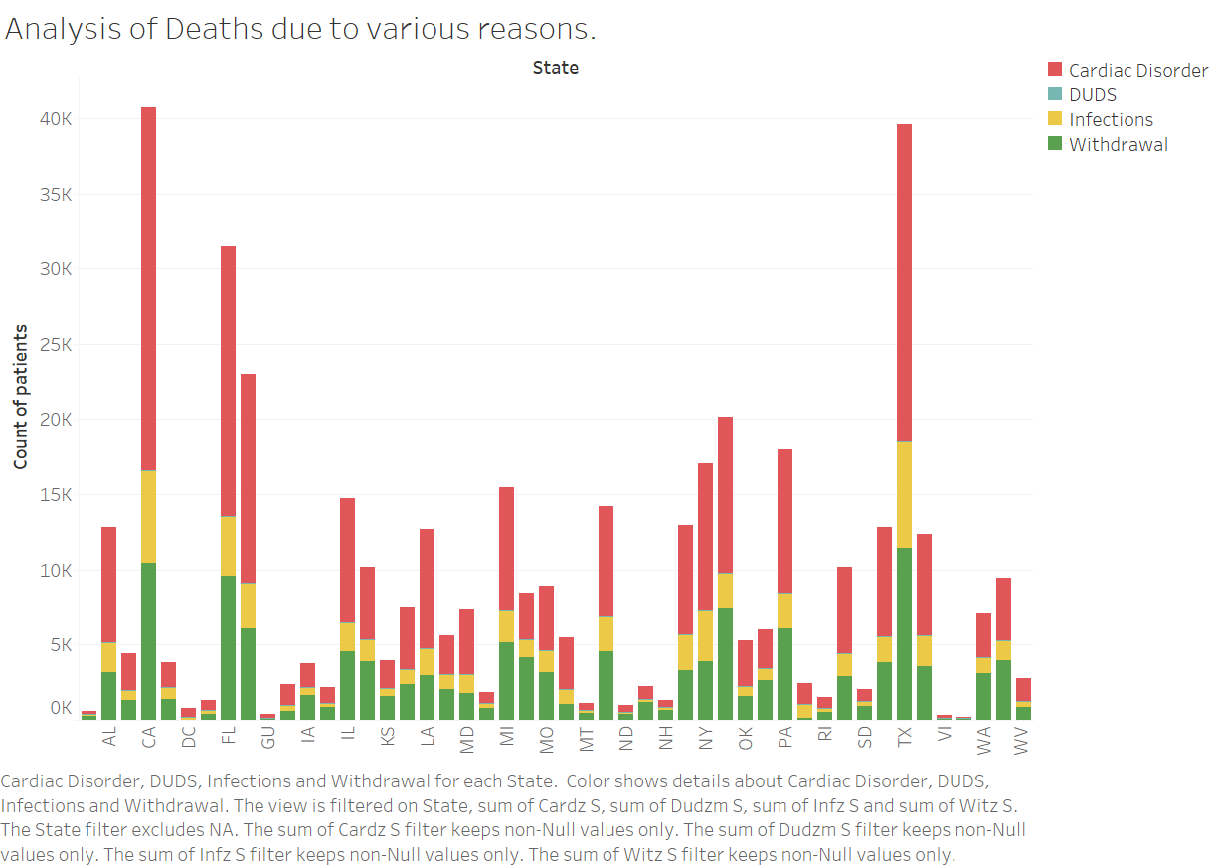


Dialysis Treatment Adequacy across the United States
Amruta Chavan (Masters in Data Science at Indiana University)
Email: amchavan@iu.edu
ABSTRACT
METHODS
Mortality in dialysis patients due to various factors was analysed. It was seen that majority of dialysis patients died of cardiac disorder. Withdrawal from dialysis treatment was another significant cause of death in renal disorder.
CONCLUSIONS
Kidney disease often has no symptoms in its early stages and can go undetected until it is very advanced. Hence, kidney disease is also referred to as a 'silent disease'. This project involves analyzing patient database across all the facilities in the US and discovering success rate of dialysis treatment. The dialysis patient data is explored based on various factors such as demographic, physiological, patient age, gender etc to find factors affecting the treatment and find correlations between features
This project uses dataset published by University of Michigan kidney Epidimiology and Cost Center together with Center of Medicare and Medicaid services.
The data was cleaned and processed in R which resulted into 210 attributes and 6337 instances and exploratory analysis was performed on the clean data in Tableau.
Regional and national averages were calculated for comparisons. Several count of patient mortality, hospitalization, and transplantation are adjusted to account for the characteristics of the patient mix at these facilities, such as age, sex and diabetes as a cause of ESRD.
Analysis of dialysis patient data provided further insight into the nature and quality of treatment. The report compared the characteristics of a facility's patients, patterns of treatment, and patterns in transplantation, hospitalization, and mortality to local and national averages to evaluate patient outcomes and to account for important differences in the patient mix-including age, sex, race, and patients' diabetic status-which in turn enhances each facility's understanding of the clinical experience relative to other facilities in the state, and nation.
INTRODUCTION
RESULTS
Dialysis is a process for removing waste and excess water from the blood and is used primarily as an artificial replacement for lost kidney function in people with kidney failure either until suitable transplant is made available or in case of acute kidney failure. This project involves analyzing patient database across all the facilities in the US and discovering success rate of dialysis treatment. The goal is to study patient characteristics, treatment patterns and patient outcomes for chronic dialysis patients.
REFERENCES
[1] DaVita.Inc, “Kidneydisorder,” DaVitaWebsite,daVita.Inc. [Online]. Available: https://www.davita.com/kidney-disease/dialysis/the-basics
[2] AmericanKidneyFund, “Renaldisorder.” [Online].Available: http://www.kidneyfund.org/kidneydisease/kidneyfailure/?referrer=https://www.google.com/
[3] “Data link.” [Online]. Available: https://dialysisdata.org/content/dialysis-facility-report-data
[4] [Online]. Available: https://www.healthdata.gov/dataset/esrd-qip-dialysis-adequacy-payment-year-2016
[5] https://en.wikipedia.org/wiki/Dialysis
Standard Mortality Ratio is crucial deciding factor when it comes to the treatment quality at dialysis clinics. It is the ratio of number of observed death to the expected value. The value of this ratio should always be less than 1. But for few states in the US, SMR value is significantly higher than 1, namely for Porto Rico and Gaum. The graph shows than these states have mortality rate almost 4.5% more than expected value.
OBJECTIVES
The aim is to study patient characteristics, treatment patterns and patient outcomes for chronic dialysis patients. The research will also include trends of type of dialysis treatment opted by the patients nation-wide, compare the success rates and scores of clinics offering the procedure region-wise and overall scores.
This report will compare the characteristics of a facility's patients, patterns of treatment, and patterns in transplantation, hospitalization, and mortality to local and national averages. Such comparisons help evaluate patient outcomes and to account for important differences in the patient mix - including age, sex, race, and patients' diabetic status - which in turn enhances each facility's understanding of the clinical experience relative to other facilities in the state and nation.
California, Texas, Florida and Illinois are the states with maximum number of dialysis facility centers.
HIGHLIGHTS
State of California,Texas,Ohio,Florida and Illinois recorded maximum number of dialysis treatment facility centers compared to rest of the states.
SMR value for Porto Rico and Guam were higher than the expected count.
Urbanized and/or highly populated states such as California , Los Angeles, New York, Ohio, Florida shows comparatively higher count of patients with renal failure.
Males were observed to possess higher risk of renal failure compared to females across the country.
The count of patients belonging to African American ethnicity was recorded higher than rest of the ethnicities.

